Slide 1
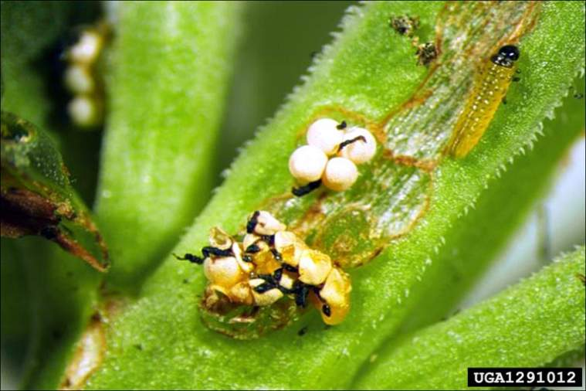
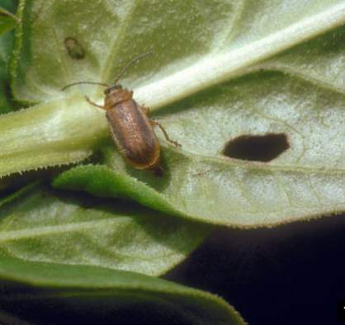
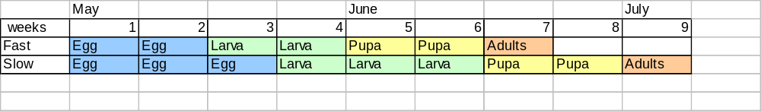
Eggs
Adult
Larva
Eric Coombs,
Oregon Department
of Agriculture, United States
Bernd Blossey, Cornell University, United States
Galerucella beetles go through 4 stages of life. Egg, Larva, Pupa, and Adult. Adults hibernate over the winter, and begin laying eggs in the spring.
Lessoning Loosestrife

Slide 2
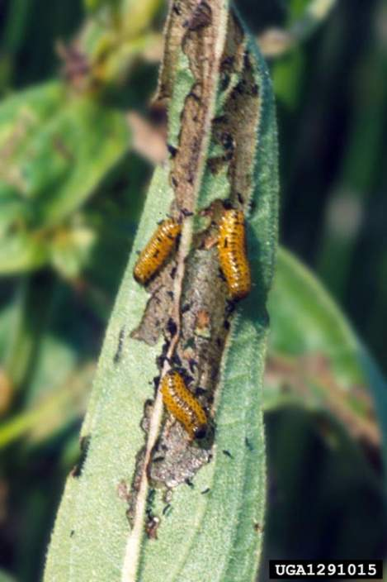
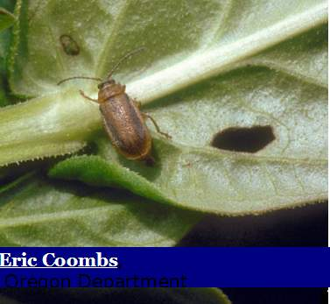
Larva feed on the leaf tips, making a windowpane pattern.
Adults eat all the way through the leaf.
Linda Wilson, University of Idaho, Bugwood.org
Lessoning Loosestrife

Slide 3
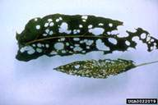
Eggs
Adult
Larva
Eric Coombs,
Oregon Department
of Agriculture, United States
Bernd Blossey, Cornell University, United States
A
Adult
Which leaf shows more damage by Adult Galerucella beetles?
Which leaf shows more damage by Galerucella beetle larva?
B
Larva
Bernd Blossey, Cornell University, United States
Lessoning Loosestrife

Slide 4

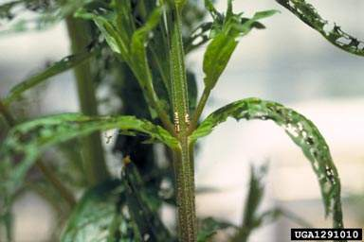
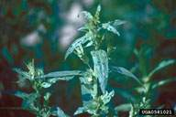

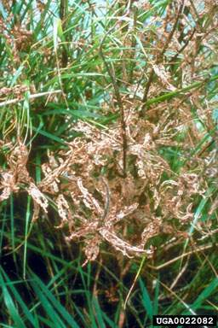

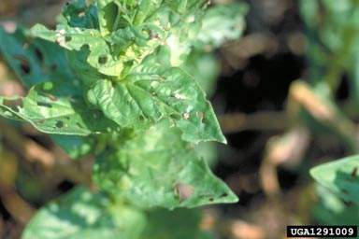

Doug Landis, Michigan State University, Bugwood.org
Chart B:
Jil M. Swearingen, USDI National Park Service, Bugwood.org
Damage Class
Estimate Damage Class
A
<1%
B
1-5%
C
6-25%
D
26-50%
E
51-75%
F
76-95%
Lessoning Loosestrife
G
>95%
Linda Wilson, University of Idaho, Bugwood.org
Bernd Blossey, Cornell University, United States

Slide 5

Chart B:
Damage Class, % cover
A
<1%
B
1-5%
C
6-25%
D
26-50%
E
51-75%
F
76-95%
G
>95%
Imagine this is your quadrate. Estimate damage class
Bernd Blossey, Cornell University, United States
Bernd Blossey, Cornell University, United States
Bernd Blossey, Cornell University, United States
Jil M. Swearingen, USDI National Park Service, Bugwood.org
Lessoning Loosestrife

Slide 6
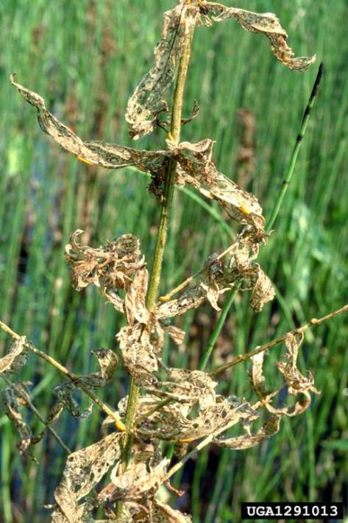

Photo by Linda Wilson, University of Idaho, Bugwood.org
Estimate Percent Damage by Larva
Based on this image, do you think beetles help control purple loosestrife?
Lessoning Loosestrife

